Slide 1
Logistic Regression and Moving Beyond Linearity
27th Feb, 2018
Data Science Bootcamp
Anindya Moitra
Shovon Sengupta
Shuvayon Dey

Slide 2
Logistic Regression

Slide 3
Modeling discrete response variables
In a very large number of problems in cognitive science and related fields, the response variable is categorical, often binary (yes/no; acceptable/not acceptable; phenomenon takes place/does not take place)
Potentially explanatory factors (independent variables) are categorical, numerical or both.
Examples: binomial/ multinomial responses
How many people answer YES to question X in the survey?
Subjects answer YES, MAYBE, NO
Subject decides to buy one of 4 different products.
Binary logistic regression is a type of regression analysis where the dependent variable is a dummy variable: coded 0 (did not vote) or 1(did vote)

Slide 4
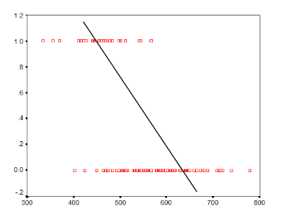
Why use logistic regression?
In the OLS regression:
Y = γ + ϕX + e ; where Y = (0, 1)
The error terms are heteroskedastic
e is not normally distributed because Y takes on only two values
The predicted probabilities can be greater than 1 or less than 0
How Logistic solve these problems?
ln[p/(1-p)] = a + bx + e; p is the probability of the event Y occurs, P(Y=1)
p/(1-p) is the odds ratio; ln[p/(1-p)] is the log odds ratio or “logit”
The logistic distribution constrains the estimated probabilities to lie between 0 and 1.
Why Bother With This Logit Function?
If we used Y as the outcome variable and tried to fit a line, it wouldn’t be a very good representation of the relationship. The following graph shows an attempt to fit a line between one X variable and a binary outcome Y.

Slide 5
Probability vs Odds Ratio
The probability that an event will occur is the fraction of times you expect to see that event in many trials. Probabilities always range between 0 and 1. If the probability of an event is 0.80 (80%), then the probability that the event will not occur is 1-0.80 = 0.20, or 20%.
The odds of an event represent the ratio of the (probability that the event will occur) / (probability that the event will not occur). This could be expressed as follows: Odds of event = Y / (1-Y)
If the probability of the event occurring = 0.80, then the odds are 0.80 / (1-0.80) = 0.80/0.20 = 4 (i.e., 4 to 1).
Examples:
If a race horse runs 100 races and wins 25 times and loses the other 75 times, the probability of winning is 25/100 = 0.25 or 25%, but the odds of the horse winning are 25/75 = 0.333 or 1 win to 3 loses.
If the horse runs 100 races and wins 5 and loses the other 95 times, the probability of winning is 0.05 or 5%, and the odds of the horse winning are 5/95 = 0.0526.
Something that never happens will have odds of 0:1 in favor, and something that always happens will have odds of 1:0 in favor (0:1 against). Odds of 1:1 are "fifty-fifty", equally like to occur or not; this corresponds to 50% probability.

Slide 6
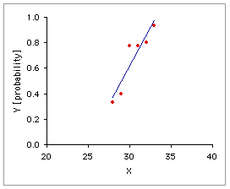
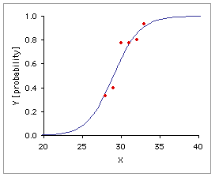
Logistic Regression - Illustration
The simple and multiple linear regression methods are used to model the relationship between a quantitative response variable and one or more quantitative explanatory variables.
However Logistic Regression performs a regression analysis when the Response Variable is dichotomous in nature.
Two Outcomes (conventionally)
‘odds’ of Success
Success
Probability = ‘p’
Failure
Probability = ‘1-p’
Independent variable (quantitative)
The equation of the logistic regression is : log [p/(1-p)] = β0 + β1 * X
Entirely quantitative model that eventually aims at calculating the β0 and β1, estimating the equation.
Then the X values are fed in from the data which yields the Log ‘odds’.
The ‘odds’ are calculated from the log odds using the logarithmic table.
Linear Regression
Since logistic function is monotonic, increase in log odds => increase in odds
The logistic transformation is to convert the function to linearity, since the probability function is as shown adjacently.

Slide 7

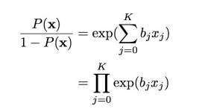

Maximum Likelihood Estimation (MLE)
MLE is a statistical method for estimating the coefficients of a model.
The likelihood function (L) measures the probability of observing the particular set of dependent variable values (p₁, p₂, ..., p_{n}) that occur in the sample: L = Prob (p₁* p₂* * * p_{n})
The higher the L, the higher the probability of observing the p_{s} in the sample.
Let the log of odds is represented by, (1)
Adding the intercept term (x₀=1) we have, (2(2)
Thus the likelihood can be represented as, (3)
Notes:
Put the MLE framework as optimizing the joint pdf (in the form of product of the two outcome)

Slide 8



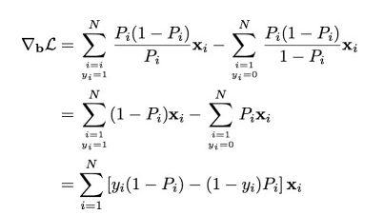

Maximum Likelihood Estimation (MLE)
Taking log on both sides of (3), we have the log likelihood function as,
(4)
Our aim is to minimize -2* (known as the deviance of the model, analogous to residual sum
of squares (RSS) to linear regression).
Taking gradient w.r.t the parameters b, we have (5)
where, P_{i}’ = P_{i}’(x_{i})
Solving for (5), we have
Note: P_{i}’(x_{i}) = P_{i}(x_{i}) (1-Pi(x_{i}))
Thus using the Newton – Raphson method, we iteratively try to solve for the equation
Notes:
Notes:
Why natural log? – Continued product of small fractions can result in extremely small numbers, called arithmetic flow. Use Natural Logs to overcome this problem.
Here is what we should now know from going through the derivation of logistic regression step by step:
Logistic regression models are multiplicative in their inputs.
The exponent of each coefficient tells you how a unit change in that input variable affects the odds ratio of the response being true.
Logistic regression is coordinate-free: translations, rotations, and rescaling of the input variables will not affect the resulting probabilities.
Logistic regression preserves the marginal probabilities of the training data.
Overly large coefficient magnitudes, overly large error bars on the coefficient estimates, and the wrong sign on a coefficient could be indications of correlated inputs.
Coefficients that tend to infinity could be a sign that an input is perfectly correlated with a subset of your responses. Or put another way, it could be a sign that this input is only really useful on a subset of your data, so perhaps it is time to segment the data.

Slide 9
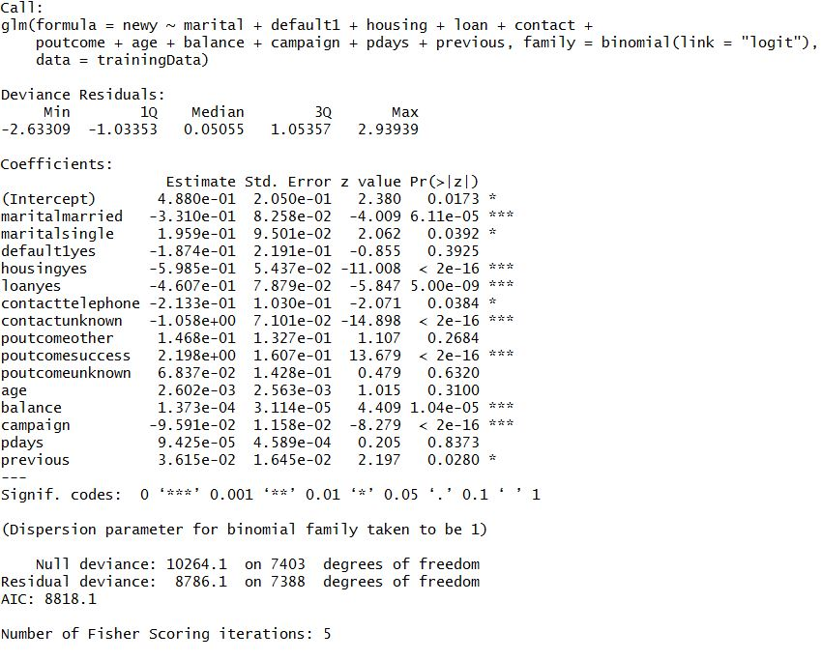
Sample output
Notes:
Parametric Estimation with regularization:
https://datascienceplus.com/logistic-regression-regularized-with-optimization/

Slide 10
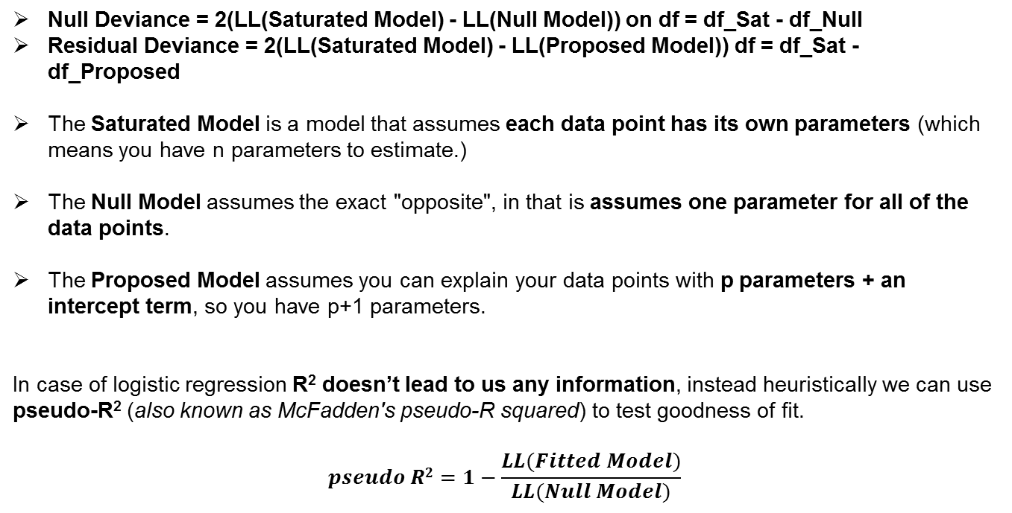
Null Deviance and Residual Deviance
Null Deviance = 2(LL(Saturated Model) - LL(Null Model)) on df = df_Sat - df_Null
Residual Deviance = 2(LL(Saturated Model) - LL(Proposed Model)) df = df_Sat - df_Proposed
The Saturated Model is a model that assumes each data point has its own parameters (which means you have n parameters to estimate.)
The Null Model assumes the exact "opposite", in that is assumes one parameter for all of the data points.
The Proposed Model assumes you can explain your data points with p parameters + an intercept term, so you have p+1 parameters.
In case of logistic regression R² doesn’t lead to us any information, instead heuristically we can use pseudo-R² (also known as McFadden's pseudo-R squared) to test goodness of fit.
$$pseudo R2=1−\frac{LL(Fitted Model)}{LL(Null Model)}$$
Notes:
Tips:
If your Null Deviance is really small, it means that the Null Model explains the data pretty well. Likewise with your Residual Deviance.
If your model is "good" then your Deviance is approx Chi^2 with (df_sat - df_model) degrees of freedom.
If you want to compare you Null model with your Proposed model, then you can look at, (Null Deviance - Residual Deviance) approx Chi^2 with df Proposed - df Null = (n-(p+1))-(n-1)=p

Slide 11
Output interpretation
Estimate - These are the binary logit regression estimates for the Parameters in the model. The logistic regression model models the log odds of a positive response (probability modeled is Y =1) as a linear combination the predictor variables. This is written as
log[ p / (1-p) ] = b₀ + b₁*x₁ + b₂*x₂ + b₃ *x₃ + …., where p is the probability that Y is 1.
We can interpret the parameter estimates as follows: for a one unit change in the predictor variable, the difference in log-odds for a positive outcome is expected to change by the respective coefficient, given the other variables in the model are held constant.
Standard Error - These are the standard errors of the individual regression coefficients. They are used in the 95% Confidence Limits.
Z value and Pr (> |z|) - These are the test statistics and p-values, respectively, testing the null hypothesis that an individual predictor's regression coefficient is zero, given the other predictor variables are in the model.
Odds ratio - The odds ratio for your coefficient is the increase in odds when you increase X by one unit When the odds ratio is greater than 1, it describes a positive relationship and an odds ratio less than 1 implies a negative relationship.
AIC - This is the Akaike Information Criterion. It is calculated as AIC = -2 Log L + 2((k-1) + s), where k is the number of levels of the dependent variable and s is the number of predictors in the model. AIC is used for the comparison of nonnested models on the same sample. Ultimately, the model with the smallest AIC is considered the best, although the AIC value itself is not meaningful.
SC - This is the Schwarz Criterion. It is defined as - 2 Log L + ((k-1) + s)*log(Σ f_{i}), where f_{i}'s are the frequency values of the i^{th} observation, and k and s were defined previously. Like AIC, SC penalizes for the number of predictors in the model and the smallest SC is most desirable and the value itself is not meaningful

Slide 12
Assessing Model Fit
Percent Concordant - A pair of observations with different observed responses is said to be concordant if the observation with the lower ordered response value (Y= 0) has a lower predicted mean score than the observation with the higher ordered response value (Y= 1).
Percent Discordant - If the observation with the lower ordered response value has a higher predicted mean score than the observation with the higher ordered response value, then the pair is discordant.
Percent Tied - If a pair of observations with different responses is neither concordant nor discordant, it is a tie.
Pairs - This is the total number of distinct pairs with one case having a positive response (Y= 1) and the other having a negative response (Y= 0).
Somers' D - Somer's D is used to determine the strength and direction of relation between pairs of variables. Its values range from -1.0 (all pairs disagree) to 1.0 (all pairs agree). It is defined as (nc-nd)/t where nc is the number of pairs that are concordant, nd the number of pairs that are discordant, and t is the number of total number of pairs with different responses. In our example, it equals the difference between the percent concordant and the percent discordant divided by 100: (85.6-14.2)/100 = 0.714.
c - c is equivalent to the well known measure ROC. c ranges from 0.5 to 1, where 0.5 corresponds to the model randomly predicting the response, and a 1 corresponds to the model perfectly discriminating the response.
Test – These are three asymptotically equivalent Chi-Square tests. They test against the null hypothesis that at least one of the predictors’ regression coefficient is not equal to zero in the model. The difference between them are where on the log-likelihood function they are evaluated.
Likelihood Ratio – This is the Likelihood Ratio (LR) Chi-Square test that at least one of the predictors’ regression coefficient is not equal to zero in the model. The LR Chi-Square statistic can be calculated by -2 Log L(null model) – 2 Log L(fitted model), where L(null model) refers to the Intercept Only model and L(fitted model) refers to the Intercept and Covariates model.
Score – This is the Score Chi-Square Test that at least one of the predictors’ regression coefficient is not equal to zero in the model.
Wald – This is the Wald Chi-Square Test that at least one of the predictors’ regression coefficient is not equal to zero in the model.

Slide 13
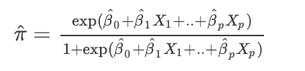
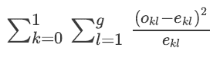
Hosmer - Lemeshow Goodness of Fit
The Hosmer-Lemeshow test is used to determine the goodness of fit of the logistic regression model. Essentially it is a chi-square goodness of fit test for grouped data, usually where the data is divided into 10 equal subgroups..
Let the predicted probabilities be,
The observations in the sample are then split into g groups according to their predicted probabilities. Suppose (as is commonly done) that g=10.
Since this is a chi-square goodness of fit test, we need to calculate the HL statistic
where o_{kl} denotes the number of observed Y=0 observations in the l^{th} group, o_{1l} denotes the number of observed Y=1observations in the l^{th} group, e_{0l} and e_{1l}and similarly denote the expected number of zeros.
Small values with large p-values indicate a good fit to the data while large values with p-values below 0.05 indicate a poor fit. The null hypothesis holds that the model fits the data.
Notes:
The null hypothesis is that the observed and expected proportions are the same across all groups. The alternative hypothesis is that the observed and expected proportions are not the same.
The Hosmer-Lemeshow test is for overall calibration error, not for any particular lack of fit such as quadratic effects. It does not properly take overfitting into account, is arbitrary to choice of bins and method of computing quantiles, and often has power that is too low.
For these reasons the Hosmer-Lemeshow test is no longer recommended. Hosmer et al have a better one d.f. omnibus test of fit, implemented in the R rms package residuals.lrmfunction.

Slide 14
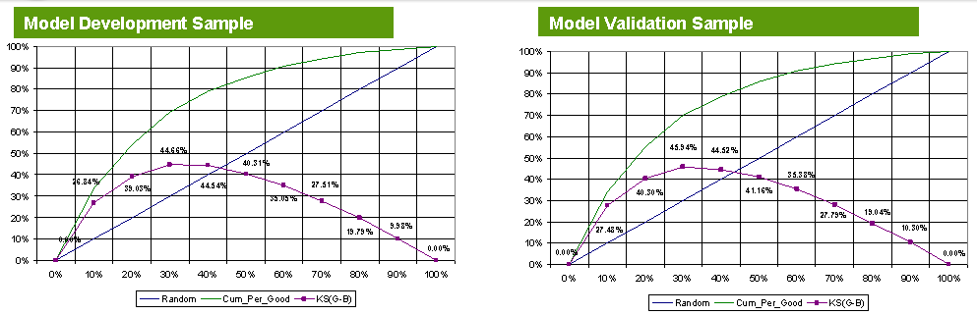
Kolmogorov-Smirnov (KS)
Kolmogorov-Smirnov (KS) measures the maximum vertical separation/deviation between the cumulative distributions of good and bads. The weakness of this method is that the separation measured only at one point (which may not be around the expected cut-off point) and not on the entire scoring range. If the intended model cut-off is at the upper or lower range of scores , this method may not give provide a very good indication of model comparison. In such cases, it might be better to compare the deviation at the intended cut-off since that is where the maximum separation is most required.

Slide 15
Confusion Matrix:
Predicted class | Actual Class |  | Marginal
 | Yes | No
Yes | True Positives (TP) | False Positive (FP) | P
No | False Negative (FN) | True Negatives (TN) | N
Marginal | P’ | N’ | Total
If these results are from a population-based study, prevalence can be calculated as follows:
Prevalence of Disease= P’/ Total
Sensitivity is the probability that a test will indicate ‘Y=1' among those with the Y=1:
Sensitivity/ Recall: TP / P’
Specificity is the fraction of those “Y=0” who will have a negative test result:
Specificity: TN / N’
Sensitivity and specificity are characteristics of the test. The population does not affect the results.
Accuracy = (TP + TN) / Total; Error rate: 1 – Accuracy
Notes:
Precision and recall are both similar to accuracy, but both are very difficult to understand conceptually. Precision is sort of like accuracy but it looks only at the data you predicted positive. Recall is also sort of like accuracy but it looks only at the data that is “relevant” in some way.
Refer: https://select-statistics.co.uk/blog/sensitivity-specificity-and-predictive-values-what-is-the-best-way-to-measure-the-performance-of-binary-classification-models/

Slide 16

Precision and F measure
A modeler and a partner have a different question: what is the chance that a person with a positive test truly default? If the subject is in the first row in the table above, what is the probability of being in cell A as compared to cell B? A modeler calculates across the row as follows:
Positive Predictive Value/ Precision: TP/(TP + FP) × 100
Negative Predictive Value: TN/(FP + TN) × 100
Perfect score for Recall is 1.0
Positive and negative predictive values are influenced by the prevalence of target in the population that is being tested. If we test in a high prevalence setting, it is more likely that persons who test positive will truly default than if the test is performed in a population with low prevalence..
F measure (F-score): harmonic mean of precision and recall, $F=\frac{2∗precision ∗recall}{precision + recall}$
Predicted class | Actual Class
 | Yes | No | Total
Yes | 90 | 210 | 300
No | 140 | 9560 | 9700
Total | 230 | 9770 | 10000
Sensitivity/ Recall
= 90/230 = 0.39
Specificity = 9560/9770 = 0.98
PPV/Precision = 90/300 = 0.30
NPV = 0.98
Accuracy = (9560+90)/10000
= 0.96
Notes:
One disadvantage of PPV and NPV is that they depend on the overall success rate in the population. Sensitivity and specificity do not have this problem – they do not depend on the overall success rate and as such they may be interpreted in absolute terms as a measure of the classifier’s performance.
We have two distinct pairs of performance measures that can be extracted from a table of classification and outcome counts. Each pair addresses a different question: sensitivity and specificity tell us about the distribution of classifications given the true outcome, while PPV and NPV give the probabilities of the outcomes given the classification. All four measures can be useful so it is wise to check them all before implementing the classifier as a decision tool.

Slide 17
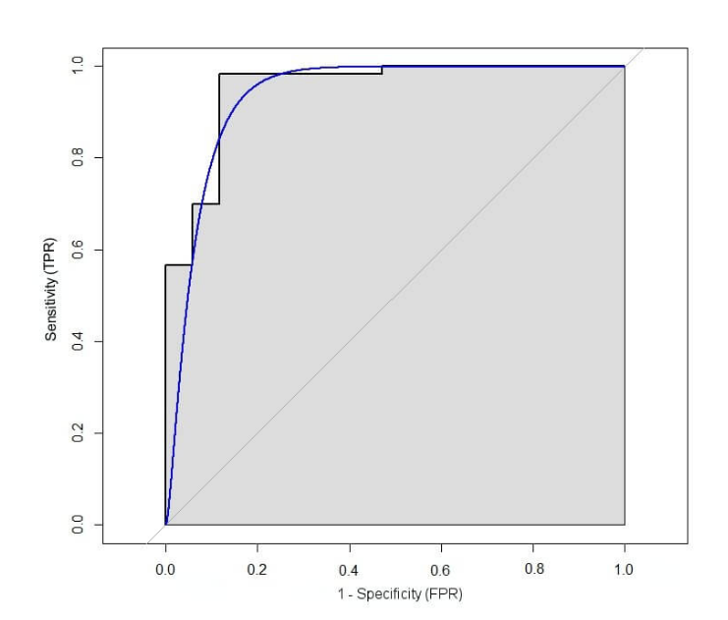
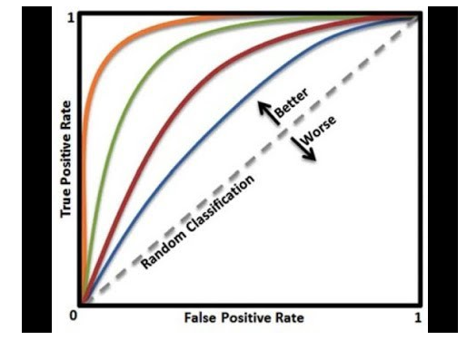
ROC
ROC – A Receiving Operating Characteristic (ROC) curve is a useful tool that allows us to examine the trade-off between these two metrics by plotting the TP against the FP for a variety of different classification thresholds. Each point on the line in Figure represents a different threshold for classification, ranging from all probabilities classified as failures in the bottom left-hand corner (i.e., 0% TP and FP) and all probabilities classified as successes in the top right-hand corner (i.e., 100% TP and FP).
This is the most powerful non-parametric two sample test and measure is equivalent to the area under the Receiver Operating Characteristics (ROC) curve, Gini co-efficient, and the Wilcoxon-Mann-Whitney test.
It measures classifier performance across all score ranges and is a better measure of overall scorecard strength.
The C-Statistics measures the area under the Sensitivity vs (1-Specificity) curve for the entire score range. The random line denotes C statistics = 0.5. Therefore for a good model, the c-statistics should be above 0.5. As per industry norms, a c-statistics above 0.7 is considered as a good model.
Notes:
The cut-off probability or threshold at which default is advised, should be chosen so that the number of times it results in a successful default far outweighs the number of times it is unsuccessful.
We can ensure that our threshold is optimised to this logic by choosing a threshold that maximises the true positive rate (TP) of the statistical model whilst minimising the false positive rate (FP). The former is the proportion of successful defaults that are correctly classified as such, whilst the FP is the proportion of failed default that were incorrectly predicted to be a success. TP is also referred to as the sensitivity and 1-FP the specificity of the model.

Slide 18
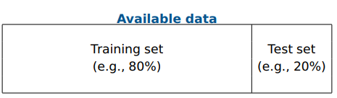
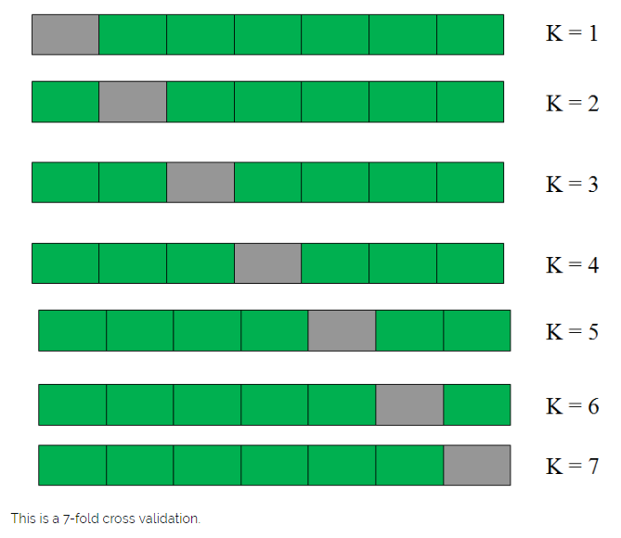
Validation Methods - Holdout & Cross-Validation
Holdout method
Given data is randomly partitioned into two independent sets
Training set (e.g., 4/5) for model construction
Test set (e.g., 1/5) for accuracy estimation
Random sampling: a variation of holdout
Repeat holdout k times, accuracy = avg. of the accuracies obtained
Cross-validation (k-fold, where k = 10 is most popular)
Randomly partition the data into k mutually exclusive subsets, each approximately equal size
At i^{th} iteration, use D_{i} as test set and others as training set
18
Notes:
Methodology:
Divide the entire population into 7 equal samples. Now we train models on 6 samples (Green boxes) and validate on 1 sample (grey box). Then, at the second iteration train the model with a different sample held as validation. In 7 iterations, we have basically built model on each sample and held each of them as validation. This is a way to reduce the selection bias and reduce the variance in prediction power. Once we have all the 7 models, we take average of the error terms to find which of the models is best.
How does this help to find best (non over-fit) model?
k-fold cross validation is widely used to check whether a model is an overfit or not. If the performance metrics at each of the k times modelling are close to each other and the mean of metric is highest.
But how do we choose k?
This is the tricky part. We have a trade off to choose k.
For a small k, we have a higher selection bias but low variance in the performances.
For a large k, we have a small selection bias but high variance in the performances.
Think of extreme cases :
k = 2 : We have only 2 samples similar to our 50-50 example. Here we build model only on 50% of the population each time. But as the validation is a significant population, the variance of validation performance is minimal.
k = number of observations (n) : This is also known as “Leave one out”. We have n samples and modelling repeated n number of times leaving only one observation out for cross validation. Hence, the selection bias is minimal but the variance of validation performance is very large.
Generally a value of k = 10 is recommended for most purpose.

Slide 19
Moving Beyond Linearity

Slide 20
Generalized Additive Models
GAMs are simply a class of statistical Models in which the usual Linear relationship between the Response and Predictors are replaced by several Non linear smooth functions to model and capture the Non linearities in the data.
These are also a flexible and smooth technique which helps us to fit Linear Models which can be either linearly or non linearly dependent on several Predictors X_{i} to capture Non linear relationships between Response and Predictors.
GAMs are just a Generalized version of Linear Models in which the Predictors X_{i} depend Linearly or Non linearly on some Smooth Non Linear functions like Splines , Polynomials or Step functions etc.
where the functions f₁, f₂, f₃ ,…. f_{p} are different Non Linear Functions on variables X_{p} .
Logistic Regression using GAM
We can also fit a Logistic Regression Model using GAMs for predicting the Probabilities of the Binary Response values. We will use the identity I() function to convert the Response to a Binary variable.
20

Slide 21

Polynomial Regression
In multiple linear regression, we have outlined ways to check assumptions of linearity by looking for curvature in various plots:
For instance, we look at the scatterplot of the residuals versus the fitted values.
We also look at a scatterplot of the residuals versus each predictor.
Sometimes, a plot of the residuals versus a predictor may suggest there is a nonlinear relationship. One way to try to account for such a relationship is through a polynomial regression model. Such a model for a single predictor, X, is:
where h is called the degree of the polynomial.
Although this model allows for a nonlinear relationship between Y and X, polynomial regression is still considered linear regression since it is linear in the regression coefficients
21

Slide 22
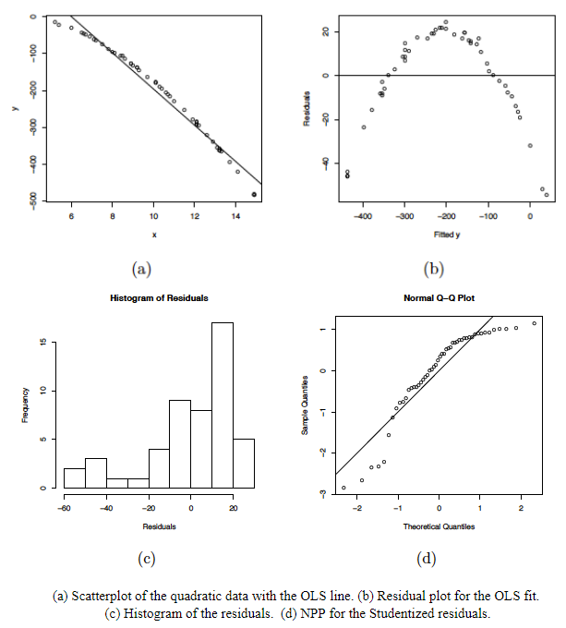
Polynomial Regression
Residuals versus predictor plots how there is obvious curvature and it does not show uniform randomness as we have seen before.
The histogram appears heavily left-skewed and does not show the ideal bell-shape for normality.
The NPP seems to deviate from a straight line and curves down at the extreme percentiles.
These plots alone suggest that there is something wrong with the model being used and indicate that a higher-order model may be needed.
22
Notes:
Some general guidelines to keep in mind when estimating a polynomial regression model are:
The fitted model is more reliable when it is built on a larger sample size n.
Do not extrapolate beyond the limits of your observed values, particularly when the polynomial function has a pronounced curve such that an extrapolation produces meaningless results beyond the scope of the model.
Consider how large the size of the predictor(s) will be when incorporating higher degree terms as this may cause numerical overflow for the statistical software being used.
Do not go strictly by low p-values to incorporate a higher degree term, but rather just use these to support your model only if the resulting residual plots looks reasonable. This is an example of a situation where you need to determine "practical significance" versus "statistical significance".

Slide 23
Poisson Regression
Suppose we are interested in knowing:
What is the expected number of credit cards a person may have, given his/her income?, or
What is the sample rate of possession of credit cards?
In Poisson regression Response/outcome variable Y is a count. But we can also have Y/t, the rate (or incidence) as the response variable, where t is an interval representing time, space or some other grouping.
GLM Model for Counts with its assumptions:
g(μ)=β₀+β₁x₁+β₂x₂+…+β_{k}x_{k}
Random component: Response Y has a Poisson distribution that is yi∼Poisson(μi) for i=1,...,N where the expected count of yi is E(Y)=μ.
Systematic component: Any set of X = (X₁, X₂, … X_{k}) are explanatory variables.
Link:
Identity link: μ=β₀+β₁x₁
Sometimes the identity link function is used in Poisson regression. This model is the same as that used in ordinary regression except that the random component is the Poisson distribution.
Issue: can yield μ < 0
23

Slide 24
Poisson Regression
Natural log link: log(μ)=β₀+β₁x₁
The Poisson regression model for counts is sometimes referred to as a “Poisson loglinear model”. We will focus on this one and a rate model for incidences.
For simplicity, with a single explanatory variable, we write: log(μ)=α+βx. This is equivalent to: μ=exp(α+βx)=exp(α)exp(βx)
Interpretation of Parameter Estimates:
exp(α) = effect on the mean of Y, that is μ, when X = 0
exp(β) = with every unit increase in X, the predictor variable has multiplicative effect of exp(β) on the mean of Y, that is μ
If β = 0, then exp(β) = 1, and the expected count, μ = E(y) = exp(α), and Y and X are not related.
If β > 0, then exp(β) > 1, and the expected count μ = E(y) is exp(β) times larger than when X = 0
If β < 0, then exp(β) < 1, and the expected count μ = E(y) is exp(β) times smaller than when X = 0
24

Slide 25
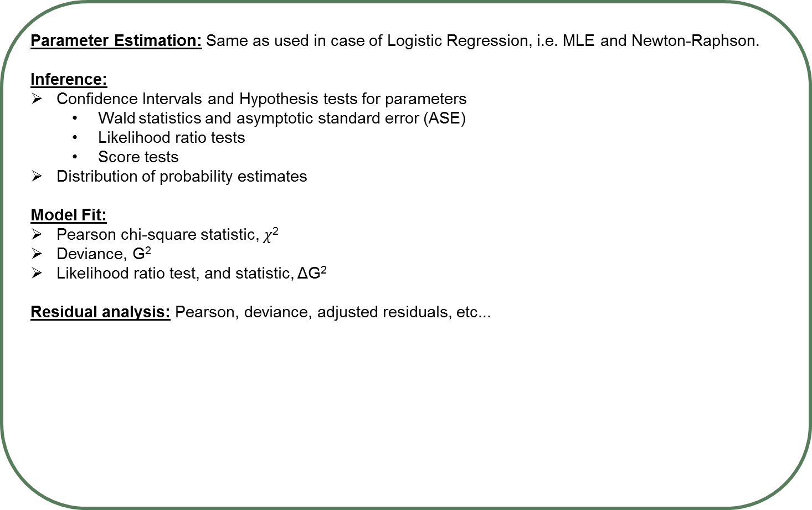
Poisson Regression
Parameter Estimation: Same as used in case of Logistic Regression, i.e. MLE and Newton-Raphson.
Inference:
Confidence Intervals and Hypothesis tests for parameters
Wald statistics and asymptotic standard error (ASE)
Likelihood ratio tests
Score tests
Distribution of probability estimates
Model Fit:
Pearson chi-square statistic, $χ$²
Deviance, G²
Likelihood ratio test, and statistic, ΔG²
Residual analysis: Pearson, deviance, adjusted residuals, etc...
25

Slide 26
Types of Logistic Regression models
Method | Description | Example | SAS Method
Binary logistic regression model | Used to model a binary (two-level) response | yes or no, Default or non - default | PROCLOGISTIC PROC GENMOD
Ordinal (ordered) logistic regression model | Used to model an ordered response — for example, low, medium, or high. | low, medium, or high. | PROC LOGISTIC - UNEQUALSLOPES/ EQUALSLOPES option in the MODEL statement PROC GENMOD - DIST=MULT option is specified in the MODEL statement.
Nominal (unordered) logistic regression model | Used to model a multilevel response with no ordering | Eye color with levels brown, green, and blue | PROC LOGISTIC - REPEATED
Discrete choice models | Used to model a response that is the choice of individuals | Transportation modes (car, bus, train, plane) | PROC BCHOISE (Bayesian choice modelling)
Logistic model for longitudinal (or repeated measures) data | These models are for a response that is observed more than once on each subject (or item), either at multiple times or under multiple conditions. The response can be binary, ordinal, or nominal. | Incidence of pulmonary disease among family members may be correlated because of hereditary factors | PROC GENMOD – REPEATED statement
26

Slide 27
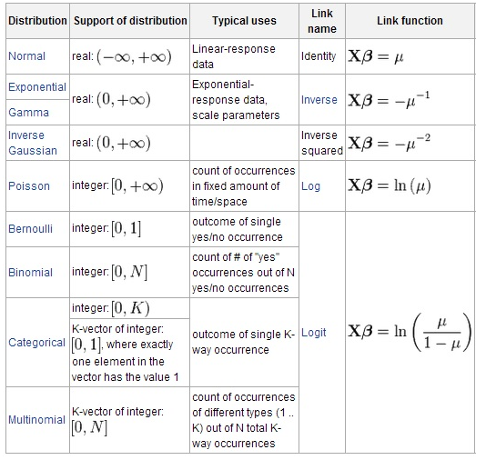
GLM in a nutshell
Three elements make up the generalized linear model:
A probability distribution from the exponential family (as outlined above).
A linear predictor η = Xβ . The linear predictor gives you information about the model’s independent variables.
The link function relates the linear predictor to the expected value. The following table shows some examples of link functions for various types of models.
Applying Logistic Regression using Regularization.
See: https://datascienceplus.com/logistic-regression-regularized-with-optimization/
27

Slide 28
Appendix
Further Reads:
http://support.sas.com/documentation/cdl/en/statug/67523/HTML/default/viewer.htm#statug_bchoice_details01.htm
http://www2.sas.com/proceedings/sugi22/STATS/PAPER278.PDF
https://www.analyticsvidhya.com/blog/2016/02/multinomial-ordinal-logistic-regression/
http://support.sas.com/kb/22/871.html
https://people.maths.bris.ac.uk/~sw15190/mgcv/tampere/mgcv.pdf
https://datascienceplus.com/logistic-regression-regularized-with-optimization/
https://stats.idre.ucla.edu/sas/output/proc-logistic/
28

